Slide 1


From Experience to Excellence
We Shape The Cybersecurity & AI Professionals
Defending and building Indonesia's digital future. Practitioner-led training, hands-on from day one — backed by PT ITSEC Asia Tbk (IDX: CYBR).
//
WHERE TOMORROW'S DEFENDERS ARE TRAINED TODAY

Slide 2
Introduction to Cybersecurity
Understanding Threats, Risks, and Digital Protection

Slide 3
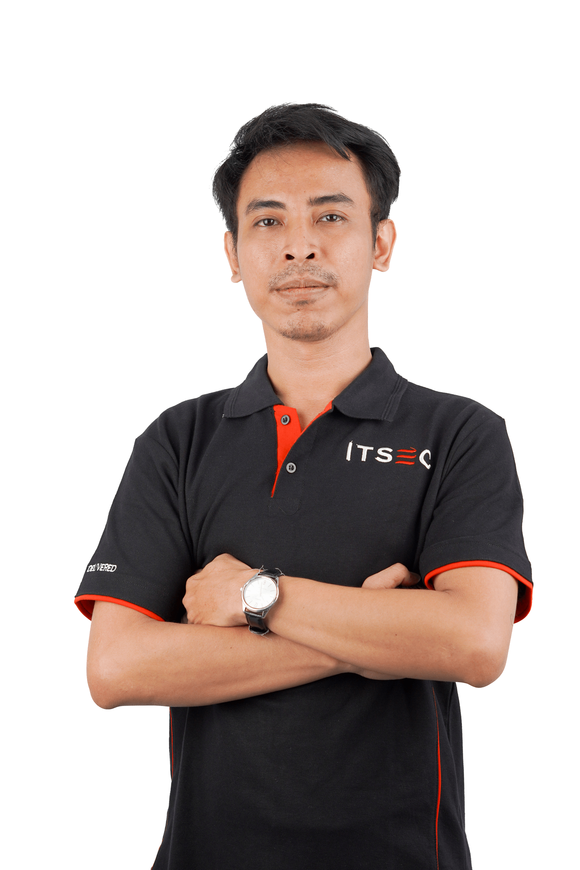
Proofpoint Certified AI Email Security Specialist
Proofpoint Certified AI Agent Security Specialist
Proofpoint Certified Email Identity Protection Specialist
ISO/IEC 27001:2022 Information Security Associate
EC Council - ISO/IEC 27001: Information Security Management
EC Council - Information Security Risk Management (ISO 27005)
EC Council - Master Exploitation Analysis Assessment
EC Council - Cyber Deception Demystified
Certified in Cybersecurity by ISC2
Fortinet - NSE 3
Fortinet Certified Associate in Cybersecurity
Fortinet Certified Fundamental – Introduction to the Threat Landscape 2.0 Self-Paced
Fortinet Certified Professional – FortiAnalyzer 7.4 Analyst Self-Paced
Fortinet Certified Professional – FortiGate 7.4 Adiministrator Self-Paced
Fortinet Certified Professional – FortiManager 7.6 Administrator Self-Paced
Fortinet Certified Professional – FortiGate 7.4 Administrator Self-Paced
Fortinet Certified Professional – FortiGate Security 7.2 Self-Paced
Fortinet Certified Professional – FortiGate Security 7.2 Self-Paced
Fortinet Certified Professional – Securte Wireless LAN 7.4 Administrator Self-Paced
Fortinet Certified Professional – FortiManager 7.4 Administrator Self-Paced
Fortinet Certified Professional – FortiSOAR 7.3 Administrator Self-Paced
Fortinet Certified Professional – FortiWeb 7.4 Administrator Self-Paced
Fortinet Certified Solution Specialist – Zero Trust Access 7.2 Self-Paced
Fortinet Certified Solution Specialist – Enterprise Firewall 7.2 Self-Paced
Fortinet Certified Solution Specialist – LAN Edge 7.0 Self-Paced
Fortinet Certified Solution Specialist – Network Security Support Engineer 7.4 Self-Paced
Fortinet Certified Solution Specialist – Security Operations 7.4 Analyst Self-Paced
Fortinet Certified Professional – FortiGate 7.6 operator Self-Paced
Palo Alto Networks Certified Cybersecurity Practitioner
Palo Alto Networks Certified Cybersecurity Apprentice
Palo Alto Networks Certified Cloud Security Professional
Palo Alto Networks Security Operations
Palo Alto Networks Cortex XSIAM: Concepts
Palo Alto Networks Threat Investigations
AWS – Cloud Practitioner Essentials
AWS – Solution Architect
AWS – Identity and Access Management (IAM)
Cisco Network Academy – Junior Cybersecurity Analsyt
Splunk – Security Operations and the Defense Analyst
Splunk – Cybersecurity Awareness
Security Analyst at ITSEC Asia
Versatile Network Engineer and Security Analyst with 5+ years of experience in designing, securing, and optimizing enterprise IT infrastructures. Proven expertise in aviation industry networking (wired, wireless, IoT, AR/VR, MPLS, BGP, OSPF) and cybersecurity operations (SIEM: Elastic, IBM QRadar; XDR: Trellix; FortiGate NGFW; Sophos Central). Adept at supporting mission-critical systems, enhancing operational resilience, and safeguarding environments against evolving cyber threats.

Slide 4
Learning Objectives
What You Will Understand by the End of This Session
Explain why cybersecurity matters to individuals and organizations.
Understand the CIA Triad and AAA security principles.
Identify common cyber threats, vulnerabilities, and attack patterns.
Understand basic Identity and Access Management concepts.
Explain fundamental network security concepts.
Understand the role of monitoring and incident response.
Recognize how Artificial Intelligence affects modern cybersecurity.

Slide 5
Why Cybersecurity Matters
“Cybersecurity is about protecting people, information, Environments and organizations.”
As services move to web, cloud, mobile, and remote access, every identity, endpoint, application, and third-party connection becomes part of the attack surface.
Trust
Continuity
Customers, partners, and users need confidence that services and data are protected.
Security helps keep systems available and recoverable during incidents.
Compliance
Decision making
Controls support legal, contractual, and policy requirements.
Clear risk language helps leaders prioritize security investment.

Slide 6
Core Security Objectives
CIA TRIAD
AAA MODEL
Confidentiality
Authentication
Only authorized people or systems can access sensitive data.
Proves who or what is requesting access.
Integrity
Authorization
Data stays accurate, complete, and protected from unauthorized change.
Defines what that identity is allowed to do.
Availability
Accounting
Systems and information remain accessible when needed.
Records activity for audit, detection, and investigation.
Practical meaning: protect the data, verify the identity, limit the access, and keep evidence of activity.

Slide 7
Common Attack Patterns
“Most incidents combine human behavior, weak identity controls, and technical exposure”
Good security work is not only technical. It also requires clear rules, scope, evidence handling, and ethical behavior.
Initial contact
Execution
Privilege & movement
Impact
Phishing, malicious link, exposed service, or stolen credential.
Malware, script, exploit, or unauthorized login.
Access expansion, credential reuse, lateral movement.
Data theft, fraud, service outage, ransomware, or persistence.
EXAMPLES TO RECOGNIZE
Credential attacks
Malware delivery
Exploitation
Password spraying, credential stuffing, brute force, and reuse of leaked passwords.
Ransomware, trojans, spyware, malicious documents, or drive-by downloads.
Unpatched systems, insecure services, weak configuration, exposed admin panels.

Slide 8
Risk, Vulnerability, and Controls
“Security decisions become clearer when risk is expressed consistently”
Risk = Threat × Vulnerability × Impact
Threat
Vulnerability
Impact
A source of potential harm: attacker, malware, disaster, human error, or process failure.
A weakness that can be abused: missing patch, weak password, misconfiguration, or exposed service.
The business consequence: downtime, data leakage, financial loss, legal exposure, or reputation damage.
CONTROL CATEGORIES
Administrative
Technical
Physical
Policy, standards, training, risk assessment, and vendor management.
Firewall, MFA, encryption, logging, endpoint protection, backup, and vulnerability management.
Badges, secure rooms, CCTV, environmental controls, and asset protection.

Slide 9
Threat Landscape
ACTOR CATEGORIES
Cybercriminals
Financial gain, credential theft, fraud, ransomware.
Hacktivists
Publicity, disruption, ideological motivation.
Insiders
Misuse by employees, contractors, or trusted partners.
Nation-state groups
Espionage, intelligence gathering, sabotage, influence.
Opportunistic attackers
Public tools, exposed services, weak passwords.

Slide 10
Governance, Policy, and Ethics
“Cybersecurity must be authorized, documented, and accountable”
Good security work is not only technical. It also requires clear rules, scope, evidence handling, and ethical behavior.
Policies and standards
Legal and regulatory context
Evidence and documentation
Define expectations for acceptable use, access, password, data handling, patching, and incident reporting.
Security activities must follow law, contract, privacy requirements, and organizational authorization.
Record what happened, when it happened, who was involved, and what actions were taken.
Ethical boundaries
Business alignment
Test only systems you are authorized to assess. Avoid unnecessary disruption and protect confidential data.
Controls should support business objectives, reduce risk, and remain practical for users and operations.

Slide 11
Identity and Access Management
“Identity is the control point for users, admins, services, and applications”
Join
Move
Use
Leave
Create identity and assign role-based access.
Review access when duties change.
Enforce strong authentication and monitor activity.
Remove access immediately when no longer needed.
Least privilege
Separation of duties
Multi-Factor Authentication
Give users, administrators, service accounts, and applications only the access needed to perform their work.
Separate critical functions so one account does not control every step of a sensitive process.
Reduce password-only risk by requiring another factor such as authenticator app, token, or biometric validation.
Operational habit: review privileged accounts regularly and remove temporary access after the task is complete.

Slide 12
Network Security Fundamentals
“The network carries data, so it must be understood and protected”
OSI & TCP/IP
IPv4 / IPv6
Communication is organized by layers, from physical to application.
Network addressing used to identify hosts and route packets.
Firewall
VPN
Traffic control based on port, protocol, application, and policy.
Encrypted tunnel for remote access or site-to-site connectivity.
Wireless
IoT / ICS
Wi‑Fi and Bluetooth must be secured against unauthorized access.
Embedded and industrial devices need segmentation and monitoring.

Slide 13
Security Operations & Incident Response
“Turning alerts into decisions and actions”
Collect
Logs from endpoint, network, cloud, identity, and applications
Detect
Correlation rules, anomaly detection, and threat intelligence
Triage
Prioritize by impact, confidence, and affected assets
Respond
Contain, eradicate, recover, and document
Security operations output: validated cases, clear evidence, understood impact, and documented remediation and mitigation actions.

Slide 14
Artifical Intelligence in Modern Cybersecurity
“AI improves detection, but also creates new risks to manage”
AI helps defenders
AI helps attackers
AI as an asset
Alert correlation, anomaly detection, log analysis, threat intelligence enrichment, and early triage automation.
More convincing phishing, deepfakes, automated reconnaissance, and more adaptive malware.
Models, datasets, prompts, outputs, plugins, and APIs should be included in asset inventory and risk assessment.
Data integrity
Privacy
Access control
BC/DR
Prevent poisoning and unauthorized dataset changes.
Avoid sending sensitive data into public AI services.
Service accounts and bots still require PoLP and review.
Back up important configurations, models, pipelines, and datasets.

Slide 15
Learning and Certification Path
“From awareness to entry-level cybersecurity roles”
Start
Build
Practice
Validate
Role
Intro to Cybersecurity
Networking Basics + Linux
Labs: logs, scanning, hardening
entry certification
SOC, IT security, security analyst, pentester, DFIR
Practice focus
Introduction to Cybersecurity is a beginner course designed to introduce the cybersecurity field.
An entry-level credential covering security principles, governance, IAM, network/ cloud, and operations/IR.
Build a portfolio: lab write-ups, basic hardening, log analysis, network fundamentals, and incident notes.

Slide 16
Key Takeaways
Cybersecurity Connects People, Processes, Technology, and Risk
Protect CIA
Confidentiality, Integrity, and Availability are the foundation for security decisions.
Understand risk
Threat, vulnerability, and impact determine which controls are prioritized.
Identity matters
IAM, MFA, least privilege, and access reviews reduce unauthorized access.
Design secure network & cloud architecture
Segmentation, defense in depth, Zero Trust, and shared responsibility are essential.
Make operations measurable
Logging, monitoring, triage, and incident response make security real.
“Cybersecurity is not just tools., it is the discipline of understanding risk and protecting assets continuously.”

Slide 17
Summary and Source Alignment
“Key takeaways for an introductory cybersecurity presentation”
Cybersecurity is a continuous process of protecting data, identities, systems, networks, and business operations by reducing risk.
Remember the basics
Think in systems
CIA, AAA, risk, least privilege, segmentation, monitoring, incident response, and ethical authorization.
People, process, technology, business context, and cloud responsibility must work together.
Keep improving
Learning sources
Use incidents, audits, labs, and lessons learned to strengthen controls over time.
Cisco Networking Academy Introduction to Cybersecurity link provided by the user; ISC2 Certified in Cybersecurity exam outline for domain alignment.
Final message: security is not a single product; it is a disciplined practice of prevention, detection, response, and continuous improvement.

Slide 18

ITSEC CYBER & AI ACADEMY
TENTANG KAMI / ABOUT
Not a bootcamp. A capability-building institution.
OUR FOUNDATION — ITSEC ASIA
16+
400+
Years of excellence
Security specialists
7000+
5
ITSEC Cyber & AI Academy is an institutional AI and cybersecurity capability academy dedicated to building organizational and leadership readiness for governments and strategic enterprises.
Projects delivered
Countries
Established as a strategic extension of ITSEC Asia's operational experience, the Academy translates real implementation insight into structured education for leaders and practitioners — helping organisations understand, manage and respond to real-world AI and cyber risk.
STANDARDS & TRUST
CREST Accredited · ISO 27001 & ISO 9001 · SMPI.LK.3/BSSN/D1/PS.02.01/04/2022
BACKED BY PT ITSEC ASIA TBK — IDX: CYBR

Slide 19

ITSEC CYBER & AI ACADEMY
WHY CHOOSE US
We don't just train. We build capability.
Four pillars that separate the Academy from every other training provider.
01
02
03
04
Expert Leadership
Real-World Curriculum
Technology Integration
Role-Based Qualifications
Instructors currently engaged in government, enterprise and military-grade operations. No retired academics.
Every lesson reconstructed from an actual incident or live threat campaign, at genuine operational pressure.
Proprietary AI-enhanced cyber range, red-vs-blue adversarial labs and OSINT environments.
Role-specific credentials — SOC Analyst, AI Governance Lead, Red Team Specialist.
WHAT YOUR ORGANISATION ACHIEVES
Institutional readiness
Governance & compliance
Operational resilience
AI-ready organisation
HIGH-IMPACT PROGRAMS · AI & CYBER · BEGINNER → EXECUTIVE · 1–5 DAYS

Slide 20

ITSEC CYBER & AI ACADEMY
TRAINING CATALOG
Take the catalog with you.
Every program, prerequisite and delivery format in one document — scan to open it on your phone or forward it to your team.
12
1–5
AI + Cyber
Programs
Days each
Beginner → Executive
OR TYPE THIS LINK
TRAINING CATALOG 2026
https://bit.ly/ITSECAcademyTrainingCatalog2026
BACKED BY PT ITSEC ASIA TBK — IDX: CYBR

